Slide 1


Hyper-V Cluster Best Practises
GOLD PARTNER:
Hlavní odborný partner:
Jan Marek | MVP, MCSE, MCSA
Principal Solution Architect at Servodata a.s.
jan.marek@servodata.net | janmarek.eu | @mcpjanmarek
Daniel Hejda | MCSE, MCSA, MCP
Team Lead and Technical consultant at Servodata a.s.
hejda@servodata.net | defense-ops.com | @daniel_hejda

Slide 2


Slide 3
Agenda
Host (Hardware + OS)
IOPS
VM Cluster Settings
CSV and BitLocker
Networking
Security

Slide 4
Host (Hardware)
Enable Jumbo Frames for iSCSI, CSV and LM Networks
Disable non-iSCSI communication types on iSCSI NICs
Don’t use NIC teaming for iSCSI NICs – use MPIO
Use 64k allocation unit size for drives hosting VHD(X)
Use the same hardware & software config on all nodes
Ensure hardware support SLAs

Slide 5
Host (OS)
Core OS Edition or Nano Server (Windows Server 2016)
Windows Update + Hotfixes
Domain Member
Antivirus Exclusions
Use BitLocker
Notes:
Cluster http://support.microsoft.com/kb/2920151
Hyper-V http://social.technet.microsoft.com/wiki/contents/articles/20885.hyper-v-update-list-for-windows-server-2012-r2.aspx
AV http://support.microsoft.com/kb/961804 and http://support.microsoft.com/kb/822158

Slide 6
Hyper-V CPU Reserve
Percentage of the total possible CPU usage of a virtual machine
  Will block a virtual machine from starting if the reserve cannot be honored by the hypervisor under peak load
  Total of all reserves on running VMs is 100%
  Only enforced when CPU resource contention occurs
Bin-Packing Problem
  4 CPU host
  VM with 4 vCPUs and a 50% reserve: 50% of host resources
  VM with 2 vCPUs and a 80% reserve: 40% of host resources
  Only one of these can be running at a time

Slide 7
Tweaking for IOPS
AKA Hyper-V storage NUMA I/O
  Each channel can send SCSI interrupts to multiple processors concurrently
Adding more channels adds IOPS potential
  Hyper-V caps number of channels based on number of virtual processors
Modify the guest OS registry:
  HKLM\System\CurrentControlSet\Enum\VMBUS\{deviceid}\{instanceid}\Device Parameters\StorChannel\ChannelCount
vCPU Count | 1 | 2 | 4 | 8 | 16 | 32 | 48 | 64
Default Channels | 1 | 1 | 1 | 1 | 1 | 2 | 3 | 4
Maximum Channels | 1 | 1 | 1 | 2 | 4 | 8 | 12 | 16

Slide 8
Tweaking for IOPS
All VM files stored on flash-based storage
  SMB 3.0, SMB Direct, Scale-Out File Server
Configured 1 virtual SCSI controller in the VM
  16 x 127 GB fixed VHDX files
Increased the storage channels from 1 to 4
Disabled the Hyper-V I/O Balancer on the host
  HKLM\SYSTEM\CurrentControlSet\Control\StorVSP\IOBalance\Enabled:0
Ran IOMETER with 16 threads on 16 targets

Slide 9
Storage QoS Components
Parent Partition (Kernel Mode)
Child Partition (Kernel Mode)
Disk
Virtual Storage Provider VSP
Fast Path Filter VSC
Virtual Storage Miniport VSC
StorPort Miniport
VMBus
Hardware
Hyper-V Hypervisor

Slide 10
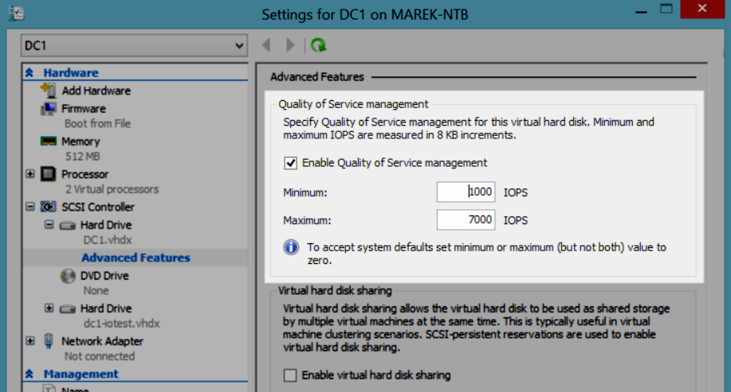
Storage QoS Configuration

Slide 11
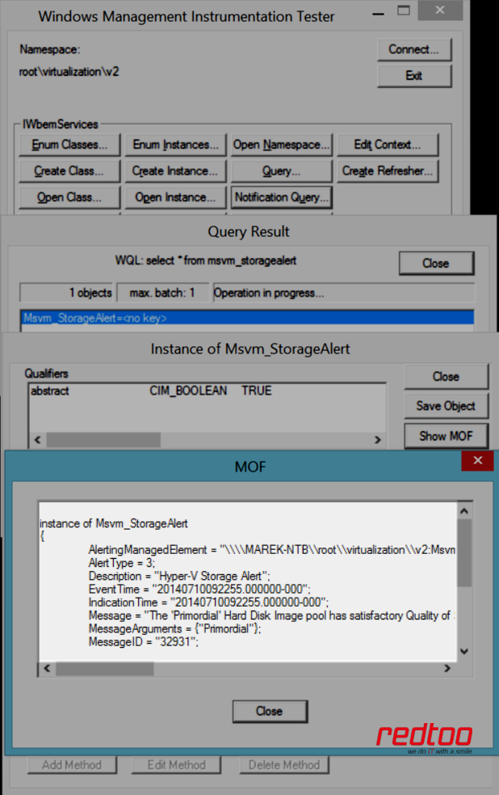
Storage QoS Events

Slide 12
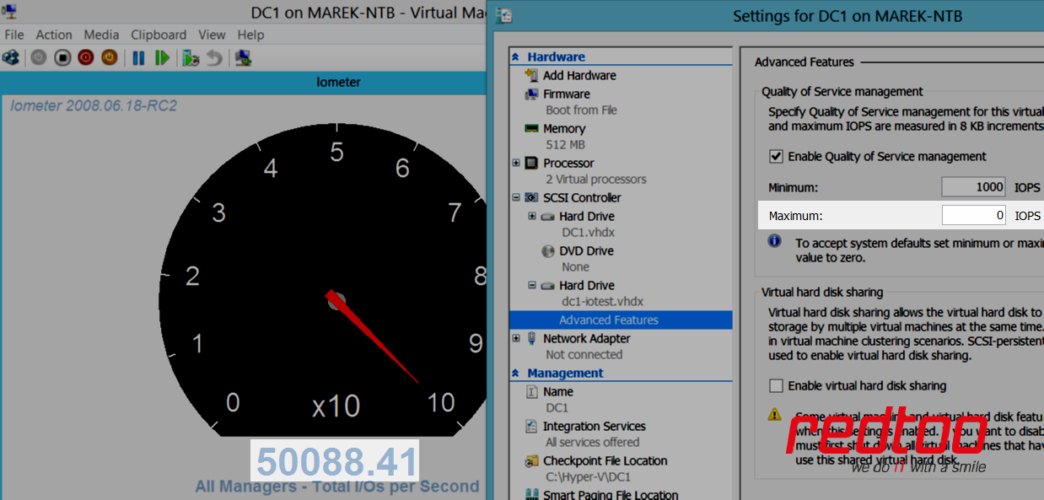

Storage QoS Experience

Slide 13
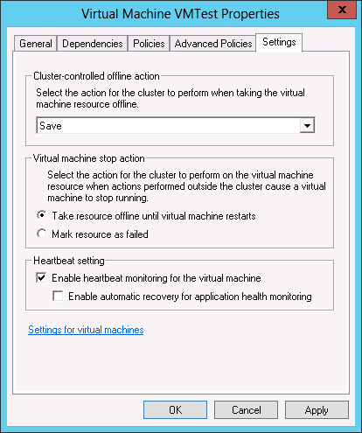
Enable VM Health Monitoring
Enable VM heartbeat setting
    Requires Integration Components (ICs)
    installed in VM
Health check for VM OS from host
    User-Mode Hangs
    System Crashes

Slide 14
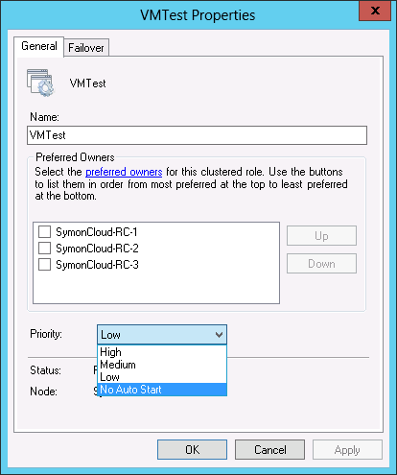
Disable Starting Low Priority VMs
‘Auto Start’ setting configures if a
VM should be automatically
started on failover
  Group property
  Disabling mark groups as lower priority
  Enabled by default
Disabled VMs needs manual
restart to recover after a crash

Slide 15
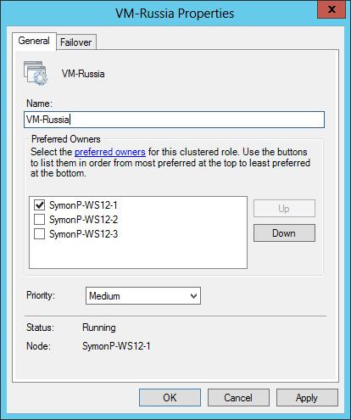
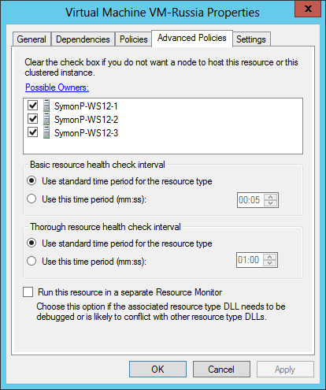
Keep VMs on Preferred Hosts
‘Preferred Owners’
  VMs will start on preferred host
‘Possible Owners’
  VMs will start on a possible owner, only if a
  preferred owner is not available
If neither a preferred or possible owner
is available, the VM will move to an
active node, but not start

Slide 16
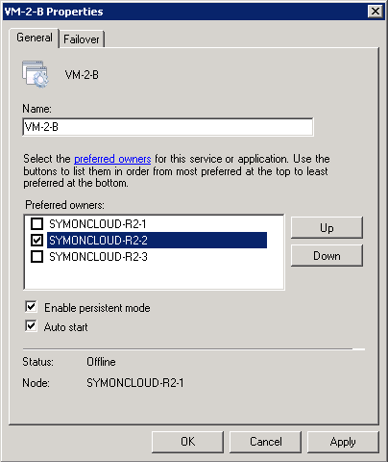
Start VMs on Preferred Hosts
‘Persistent Mode’ will attempt to place VMs back on the last node they were hosted on during start
  Only takes affect when complete cluster is started up
  Prevents overloading the first nodes that startup
  with large numbers of VMs
Better VM distribution after
cold start
Enabled by default for VM groups
  Option is hidden from GUI in 2012+

Slide 17
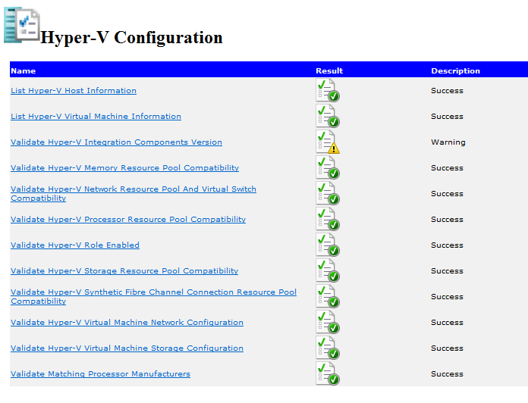
Cluster Validation
Faster storage validation
Select a specific LUN
Replicated storage
for multi-site clusters
New Hyper-V Tests
  Run when Hyper-V role is installed
  Integration Components
  Memory Compatibility
  Virtual Switch Compatibility
  Hyper-V Role Enabled
  Network Configuration
  Storage Configuration
Run Cluster Validation Test periodically!

Slide 18
VM Drain on Shutdown
VMs live migrated to another node during shutdown
VMs moved to “Best Available Node” (most free memory)
Honors VM prioritization
Ensures reboot / shutdown does not incur
downtime to VMs for unknowing admin
Enabled/Disabled via the
DrainOnShutdown cluster common property
Configure Host Shutdown Time
  HKLM\Cluster\ShutdownTimeoutInMinutes

Slide 19
Cluster Shared Volumes (CSV)
Distributed access file system
New roles
  File Server - Scale out File Server
  Hyper-V over SMB
Improved backup, performance and resiliency
Direct I/O for more scenarios
  Better VM creation and copy performance
Multi-subnet support for live migration
Use CSV cache for read-oriented VMs (VDI)
  (Get-Cluster).BlockCacheSize = 1024

Slide 20
BitLocker & CSV
We can encrypt local drives on hosts with BitLocker
We can now encrypt a cluster’s CSVs using BitLocker
  WS2012 domain controller is required
  WS2012 or later clustered hosts
  CSV formatted with NTFS
  Can encrypt before or after adding to cluster
Has some, but minimal, impact on performance
  Implement this where security trumps peak performance
  Physically insecure locations such as CiBs placed in pop-up branch offices

Slide 21
Encrypting an Existing CSV
On each node:
Add-WindowsFeature BitLocker
Get-ClusterSharedVolume “Cluster Disk 1” | Suspend-ClusterResource
$SecureString = ConvertTo-SecureString <password> -AsPlainText -Force
Enable-BitLocker C:\ClusterStorage\Volume1 -PasswordProtector –Password $SecureString
$CNO = (Get-Cluster).Name + “$”
Add-BitLockerKeyProtector C:\ClusterStorage\Volume1 -ADAccountOrGroupProtector –ADAccountOrGroup $CNO
Get-ClusterSharedVolume “Cluster Disk 1” | Resume-ClusterResource

Slide 22
Highly Available Virtual Machine Priority
We can select the priority of HA virtual machines:
  High: 3000
  Medium (Default): 2000
  Low: 1000
  No auto start: 0
Failover Clustering uses priority:
  Order the failover of VMs when a host fails
  Prioritize VMs when there are resource shortages
  Can even be used to use Quick Migration when you pause a host

Slide 23
Overriding Specific HA VM Move Type
VMs move using Live Migration when you pause a host
  You can change this to Quick Migration
Cluster property: MoveTypeThreshold
  Alter which priorities of VMs use Live Migration
Configure the DefaultMoveType of the VM cluster resource:
    -1 (4294967295): Use the cluster MoveTypeThreshold
    1: Save VM AKA Quick Migration
    4: Live Migration

Slide 24
Manipulating HA VM Priority
Get-ClusterGroup | Select-Object Name, Priority
(Get-ClusterGroup VM01).Priority = 3000

Slide 25
Enable Quick Migration on WS2012 R2
WS2012 R2 uses has MoveTypeThreshold set to 1000. You can enable Quick Migration as the Pause move type for VMs.
Get-ClusterResourceType "Virtual Machine" | `
Set-ClusterParameter @{MoveTypeThreshold=2000}
Get-ClusterResourceType "Virtual Machine" | `
Get-ClusterParameter MoveTypeThreshold

Slide 26
How to Configure VM Override
Enable Quick Migration:
Get-ClusterResource “VM01" | Set-ClusterParameter DefaultMoveType 1
Enable Live Migration:
Get-ClusterResource “VM01" | Set-ClusterParameter DefaultMoveType 4

Slide 27
Highly Available VM Anti-Affinity
High service availability is implemented at the guest layer
High service availability starts with fabric and compute resources
  Storage, networking, and Hyper-V Clusters
We can also make services highly available
  Designed-for-cloud services
  Guest clustering (see shared VHDX and virtual fibre channel)
  Load balancing (see LB appliance integration in SCVMM)
Pointless to place such VMs on the same host
This is why we have anti-affinity

Slide 28
Keep VMs off the Same Host
AntiAffinityClassNames
  Groups with same AACN try to avoid moving to same node
Configured by PowerShell directly on the cluster
System Center 2012 VMM has a GUI “Availability Groups”
Enables VM distribution across host nodes
Better utilization of host OS resources
Scenarios
  Separate similar VMs
    Guest cluster nodes
    DCs or infrastructure servers
  Separate tenets
For affinity, use preferred owners

Slide 29
How VM Anti-Affinity Works
Placing VMs in different fault domains
VMs in the same collection “repel” each other
Failover Clustering, using best effort, will place VMs in the same group on different hosts
Web
Web
Host
Host
SAN

Slide 30
Enabling Anti-Affinity
$MySvcAntiAffinity = New-Object System.Collections.Specialized.StringCollection
$MySvcAntiAffinity.Add(“My HA Service”)
(Get-ClusterGroup –Name VM01).AntiAffinityClassNames = $MySvcAntiAffinity
(Get-ClusterGroup –Name VM02).AntiAffinityClassNames = $MySvcAntiAffinity

Slide 31
Protected Networks
Failover Clustering has a heartbeat mechanism for host failure
  Doesn’t handle virtual machines losing their network connection
By default, every HA VM on WS2012 R2 has Protected Network setting enabled
  This is a feature implemented by Failover Clustering
Detects a virtual switch losing network connection
  Virtual machine will live migrate to a capable host with corresponding connected virtual switch

Slide 32
Cluster Networking
Separate Network Communication
  Mgmt | VM | LM | HB | CSV | iSCSI | Backup
Prioritize HB traffic
New-NetQoSPolicy –IPDstPort 3343 –Piority 6
Set preferred network for CSV communication
New-SmbMultichannelConstraint -InterfaceAlias "Cluster-CSV" or
(Get-ClusterNetwork "Cluster Network 1").Metric = 700
New-NetQoSPolicy –SMB –MinimumBandwidthWeightAction 20
LM: for >10Gbps use RDMA, for <10Gbps use compression
Notes:
http://technet.microsoft.com/cs-cz/library/ff182335(v=ws.10).aspx ( CSV network )

Slide 33
SMB storage
Use 10Gbps RDMA NICs
Use Storage Spaces Write-Back Cache
Async Hyper-V cluster is not supported
Hosting SMB storage (for Hyper-V Cluster) inside VM running on Hyper-V Cluster is not supported ;)

Slide 34
SECURITY
in the Windows Failover Cluster (for Hyper-V)

Slide 35


Slide 36
Accounts in failover cluster
Authentication
  Each account uses Kerberos Authentication, when it can
  When the Kerberos is not available, NTLM is used
Failover cluster doesn‘t need Domain Admins privileges
  Minimum need privileges
  Local Admin on all nodes in cluster
  Permissions to create computer object in Active Directory
User Account creates main Cluster Name Object (CNO) in ADDS
  Default policy – every 7 days changes its password
  Different Classic Computer Object – every 30 days changes its password
Other CNOs are created by main CNO – do not use Full Control on OU

Slide 37
Where/who finds any information
Network administrator
  Live migration network access
  Heartbeat + CSV metadata/redir.
  Virtual Machine network access
  Storage network access
  Management Network Access
Cluster administrator
  Port Mirroring
  He can sniff the communication, if don‘t use encrypted communication
  Restart not required on a VM after configuration of mirroring mode
MitM attackers
  If connected to physical switch and sniffing communication
by default not encrypted

Slide 38
Cluster communication
Heartbeat + CSV traffic
  Healthcheck in cluster (heartbeat)
  Cluster shared volume communication between CSV owner and non-owner
  Backup Cluster Shared Volume
  High Availability
Virtual Machine access
  Owns communication of virtual machine out/in cluster
Management access
  Management of Hyper-V Cluster
  Communication with SCVMM
Private Access – you must defend
inside the cluster
Public Access – you must defend
outside the cluster
Public Access – you must defend
outside the cluster

Slide 39
Cluster communication
Storage Communication
  Data transfers between the NODE and SAN
  iSCSI communication in the cluster (L3 sec.)
  SMB communication in the cluster (L2 sec.)
    SMB signing / encryption (MS recommends)
Live migration
  Memory transfers of running VMs
  State transfers
Private Access – you must defend
outside the cluster
Private Access – you must defend
inside the cluster
  You must have separate adapter for each and every network, if you want encrypted communication, because…

Slide 40
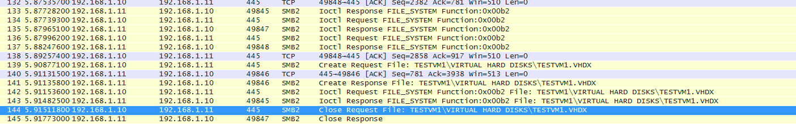
Live migration
  By default it isn‘t encrypted
  During Live Migration these informations are transferred in a plain text
    Path to Cluster Shared Volume
    Name and path to VHD file
    Operating system version
    IP and MAC information of all adapters of the migrated VM
    Domain Name of the cluster node
    Account name for Live Migration
      SSP_AUTH – Failover Cluster Local Indentity
      Automatically changes its password every 30 days

Slide 41
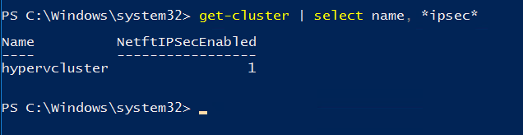
Inter-Node Cluster Communication
  Don‘t use the same adapter for Live migration and Inter-node communication
  By default inter-node communication isn‘t encrypted
  WHY???
NETFTIPSecEnabled - PROBLEM with IPSec
  if propagate Group Policy from AD longer than 10 sec in same subnet
  and 20 sec in another subnet may be NODE or Quorum disk disconected
  you can change this settings from powershell and set more security
  (Get-Cluster).NetFTIPSecEnabled = 0
    0 – IPSec is Turned OFF
      Overrides GPO settings
    1 – IPSec is Turned ON
      Enable GPO settings
Notes:
K latencím může docházet jelikož IPSec je závislý na službě Active Directory Domain Services a šifrování je vždy zahájeno pokud jsou dané skupinové politiky doreplikovány na každý node z clusteru. V případě, že propagace skupinových politik trvá dlouho (spousty nastavení v rámci Group Policy nebo špatné umístění objektu clusteru a jednotlivých node v OU, popřípadě špatným cílením skupinových politik v AD) dojde k nedostupnosti nodu a tím i jeho odpojení z clusteru, popřípadě k odpojení Quorum disku.

Slide 42
Security in Failover Cluster
Shielded VM (Windows Server 2016) = on-the-fly security
IPSec the Live Migration traffic
Use dedicated accounts for management of
  Network
  Cluster
  Virtual machine OS
  Forest and Domain
  Other…
Port security, MAC sec on top of the rack (TOR) switch
Implement the cluster on CORE Server (Windows Server 2012 R2)
Implement the cluster on NANO Server (Windows Server 2016)

Slide 43
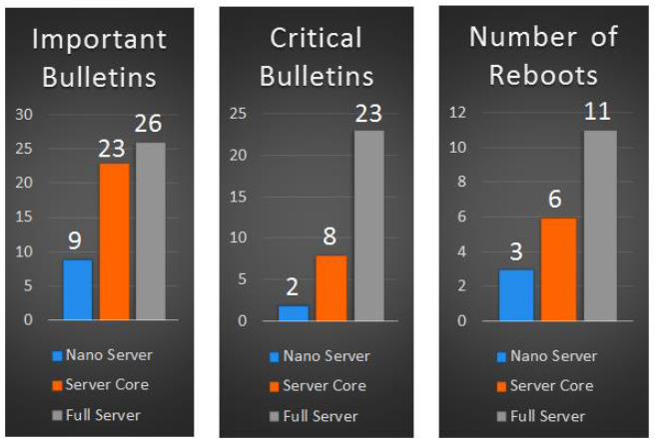
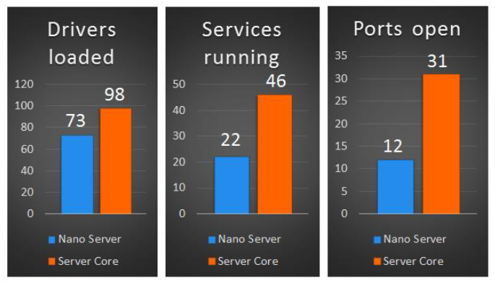
Higher security in Windows Server 2016
Eliminates number if restarts
Only core components used
* values per 12 months

Slide 44



Aktuální a navazující kurzy sledujte na www.gopas.cz
DÁREK PRO VÁS!
Vyplňte dotazníkové hodnocení a…
…získejte tričko TechEd-DevCon 2016!
SOUTĚŽ! SOUTĚŽ! SOUTĚŽ!
TechEd party!
Xbowling Strašnice, 18. 5. 2016
Buďte The Best IT Pro
nebo The Best Developer

